Slide 1
Feedforward Multilayer Neural Network

Slide 2
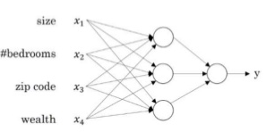
Example: predicting house price
family size?
?
Walkability?
?
price
?
school quality?
NN automatically detect hidden features (the semantics is left to us!)
e.g., if first hidden unit has input weight from zip code and wealth close to 0, then the interpretation as family size is reasonable

Slide 3
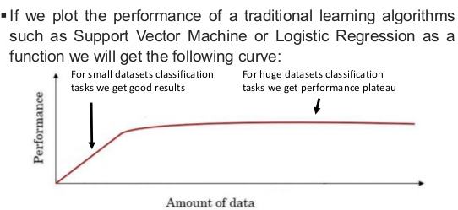

Slide 4
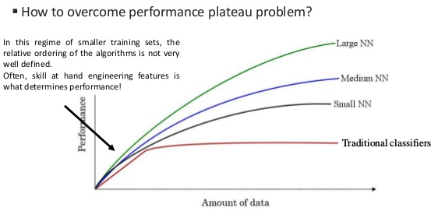
Ꝩ
labeled

Slide 5
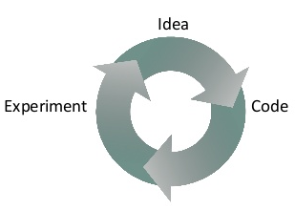
Scale drives Deep Learning
Data
  More data and deeper models
Computation
  Speed-up in computation
Algorithms
  New methods (e.g. switching from sigmoid to ReLU)
Fast computation allows testing more models
and architectures

Slide 6

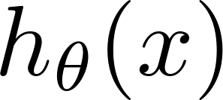







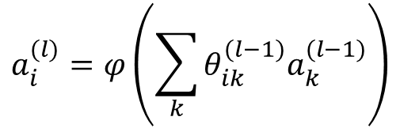








NN Recap
Neuron model
Forward propagation
$$a^{(1)}$$
$$a^{(2)}$$
$$a^{(3)}$$
$$a^{(4)}$$
x₀
Bias unit (=1)
$$θ_{0}$$
$$θ_{1}$$
$$θ_{2}$$
$$φ(∙)$$
$$y$$
$$θ_{3}$$
Layer 1
Layer 2
Layer 3
Layer 4
$$y=φ\left(\sum_{i}{θ_{i}x_{i}}\right)$$
Activation function
$$a_{i}^{(1)}=x_{i}$$
$$a_{i}^{(l)}=φ\left(\sum_{k}{θ_{ik}^{(l−1)}a_{k}^{(l−1)}}\right)$$
$$1<l≤L$$

Slide 7



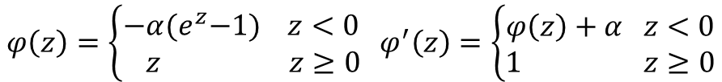



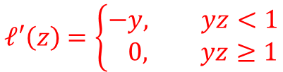
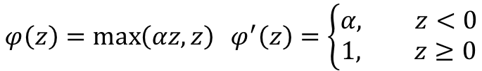
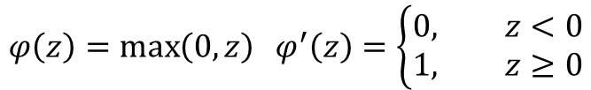






NN Recap
Activation Functions
Loss functions
$$y: \text{expected} \text{value}\text{; }\hat{y}: \text{predicted} \text{value}$$
$$φ\left(z\right)=\frac{1}{1+e^{−z}} { φ}^{′}\left(z\right)=φ(z)(1−φ(z)$$
$$y∈ℝ\text{ (}\text{regression}\text{)}$$
$$square loss: ℓ\left(\hat{y},y\right)=\frac{1}{2}{\left(\hat{y}−y\right)}^{2}$$
$$ℓ^{′}\left(z\right)=z−y$$
$$φ\left(z\right)=\frac{e^{z}−e^{−z}}{e^{z}+e^{−z}} φ^{′}\left(z\right)=1−{φ(z)}^{2}$$
$$y∈\text{\{0,1) (}\text{class}\text{.)}$$
log (cross entropy) loss:$ℓ\left(\hat{y},y\right)=−y\log\left(\hat{y}\right)−\left(1−y\right)\log{(1−\hat{y}})$
$$ℓ^{′}\left(z\right)=\frac{z−y}{z(1−z)}$$
$$φ\left(z\right)=\max\left(0,z\right) φ^{′}\left(z\right)=\left\{\begin{aligned}0, z<0 \\ &1, z≥0\end{aligned}\right.$$
$$y∈\text{\{−1,+1) (}\text{class}\text{.)}$$
$$ℓ^{′}\left(z\right)=−\frac{ye^{−yz}}{1+e^{−yz}}$$
$$\text{logistic} \text{loss}\text{: }ℓ\left(z\right)=\log{(1+e^{−yz})}$$
$$\text{hinge} \text{loss}\text{: }ℓ(z)=\max{(0,1−yz)}$$
$$φ\left(z\right)=\max\left(αz,z\right) φ^{′}\left(z\right)=\left\{\begin{aligned}α, z<0 \\ &1, z≥0\end{aligned}\right.$$
$$ℓ′\left(z\right)=\left\{\begin{aligned}−&y, yz<1 \\ &0, yz≥1\end{aligned}\right.$$
$$φ\left(z\right)=\left\{\begin{aligned}−&α{(e}^{z}−1) z<0 \\ &z z≥0\end{aligned}\right. φ^{′}\left(z\right)=\left\{\begin{aligned}φ\left(z\right)+α z<0 \\ &1 z≥0\end{aligned}\right.$$

Slide 8
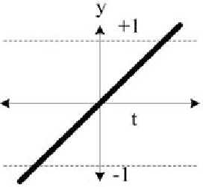



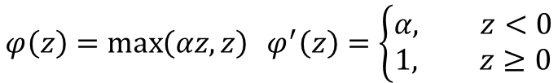
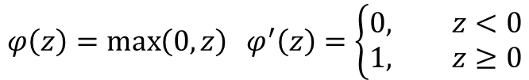



NN Recap
Activation Functions
Loss functions
Linear/Identity
$$y: \text{expected} \text{value}\text{; }z: \text{predicted} \text{value}$$
$$φ\left(z\right)=z φ^{′}\left(z\right)=1$$
$$y∈ℝ\text{ (}\text{regression}\text{)}$$
$$square loss: ℓ\left(z,y\right)=\frac{1}{2}{\left(z−y\right)}^{2}$$
$$ℓ^{′}\left(z\right)=z−y$$
$$φ\left(z\right)=\frac{1}{1+e^{−z}} { φ}^{′}\left(z\right)=φ(z)(1−φ\left(z\right))$$
$$y∈\text{\{0,1) (}\text{class}\text{.)}$$
log (cross entropy) loss:$ℓ\left(z,y\right)=−y\log\left(z\right)−\left(1−y\right)\log{(1−z)}$
$$ℓ^{′}\left(z\right)=\frac{z−y}{z(1−z)}$$
$$φ\left(z\right)=\frac{e^{z}−e^{−z}}{e^{z}+e^{−z}} φ^{′}\left(z\right)=1−{φ(z)}^{2}$$
$$y∈\text{\{−1,+1) (}\text{class}\text{.)}$$
$$ℓ^{′}\left(z\right)=−\frac{ye^{−yz}}{1+e^{−yz}}$$
$$\text{logistic} \text{loss}\text{: }ℓ\left(z,y\right)=\log{(1+e^{−yz})}$$
$$\text{hinge} \text{loss}\text{: }ℓ(z,y)=\max{(0,1−yz)}$$
$$φ\left(z\right)=\max\left(0,z\right) φ^{′}\left(z\right)=\left\{\begin{aligned}0, z<0 \\ &1, z≥0\end{aligned}\right.$$
$$ℓ′\left(z\right)=\left\{\begin{aligned}−&y, yz<1 \\ &0, yz≥1\end{aligned}\right.$$
$$φ\left(z\right)=\max\left(αz,z\right) φ^{′}\left(z\right)=\left\{\begin{aligned}α, z<0 \\ &1, z≥0\end{aligned}\right.$$

Slide 9
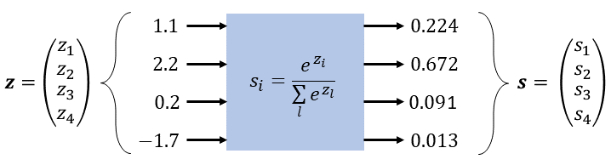





NN Recap
Activation Functions
Loss functions
Linear/Identity
$$y: \text{expected} \text{value}\text{; }z: \text{predicted} \text{value}$$
$$φ\left(z\right)=z φ^{′}\left(z\right)=1$$
$$y,z∈ℝ\text{ (}\text{regression}\text{)}$$
$$square loss: ℓ\left(z,y\right)=\frac{1}{2}{\left(z−y\right)}^{2}$$
$$ℓ^{′}\left(z\right)=z−y$$
$$φ\left(z\right)=\frac{1}{1+e^{−z}} { φ}^{′}\left(z\right)=φ(z)(1−φ\left(z\right))$$
$$y∈\text{\{0,1}\}^{C}\text{ , }\text{z}∈ℝ^{C}\text{(}\text{class}\text{.)}$$
$$ℓ\left(z,y\right)=−\sum_{i=1}^{C}{y_{i}\log{s_{i}}}$$
log (cross entropy) loss:
$$s_{i}=\frac{e^{z_{i}^{}}}{\sum_{j=1}^{C}{e^{z_{j}}}}$$
$$φ\left(z\right)=\frac{e^{z}−e^{−z}}{e^{z}+e^{−z}} φ^{′}\left(z\right)=1−{φ(z)}^{2}$$
$$ℓ^{′}\left(z_{i}\right)=s_{i}−y_{i}$$
$$φ\left(z\right)=\max\left(0,z\right) φ^{′}\left(z\right)=\left\{\begin{aligned}0, z<0 \\ &1, z≥0\end{aligned}\right.$$
$$φ\left(z\right)=\max\left(αz,z\right) φ^{′}\left(z\right)=\left\{\begin{aligned}α, z<0 \\ &1, z≥0\end{aligned}\right.$$

Slide 10
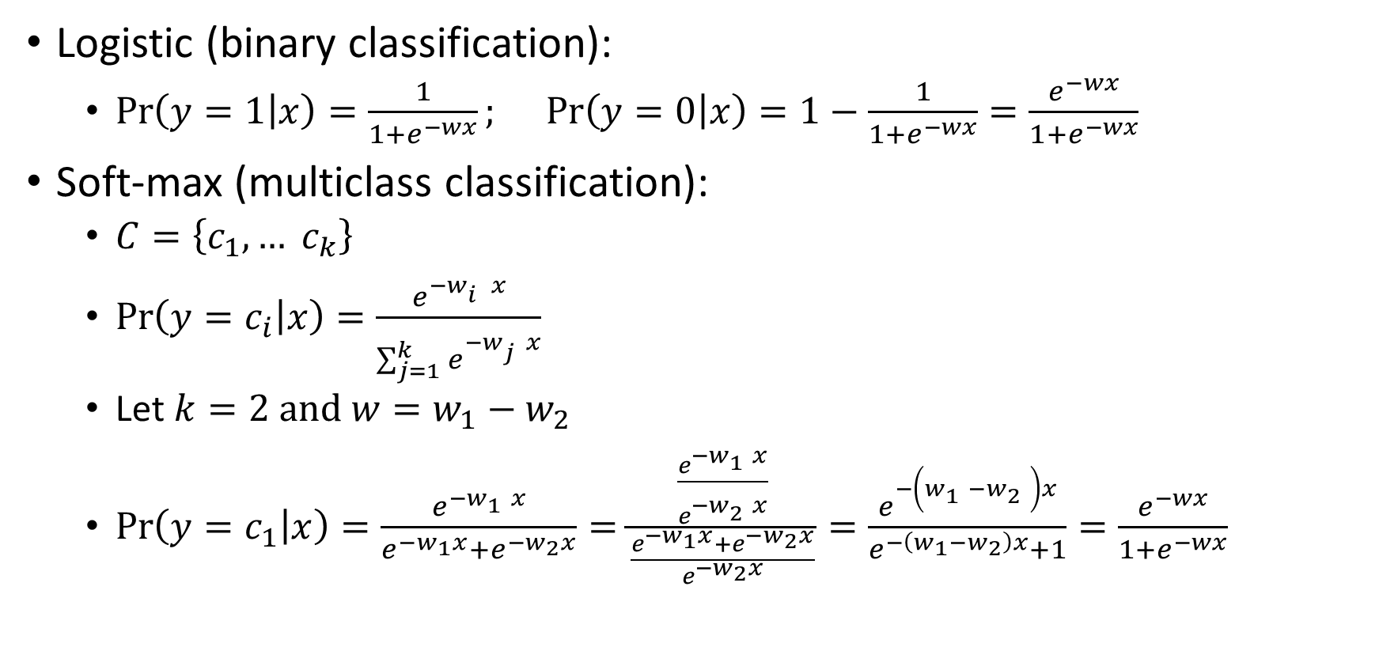
Logistic as special case of soft-max
Logistic (binary classification):
  $\operatorname{Pr}\left(y=1 | x\right)=\frac{1}{1+e^{−wx}}; \operatorname{Pr}\left(y=0 | x\right)=1−\frac{1}{1+e^{−wx}}=\frac{e^{−wx}}{1+e^{−wx}}$
Soft-max (multiclass classification):
  $C=\left\{c_{1},… c_{k}\right\}$
  $\operatorname{Pr}\left(y=c_{i} | x\right)=\frac{e^{{−w}_{i}^{}x}}{\sum_{j=1}^{k}{e^{{−w}_{j}^{}x}}}$
  Let $k=2 \text{and} w=w_{1}−w_{2}$
  $\operatorname{Pr}\left(y=c_{1} | x\right)=\frac{e^{−w_{1}^{}x}}{e^{−w_{1}x}+e^{−w_{2}x}}=\frac{\frac{e^{−w_{1}^{}x}}{e^{−w_{2}^{}x}}}{\frac{e^{−w_{1}x}+e^{−w_{2}x}}{e^{−w_{2}x}}}=\frac{e^{−\left(w_{1}^{}−w_{2}^{}\right)x}}{e^{−\left(w_{1}−w_{2}\right)x}+1}=\frac{e^{−wx}}{1+e^{−wx}}$

Slide 11



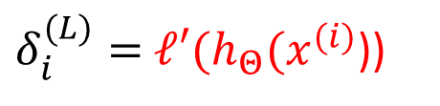


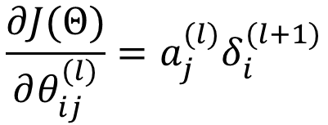

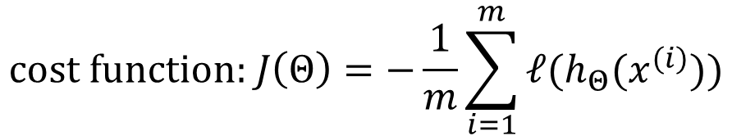
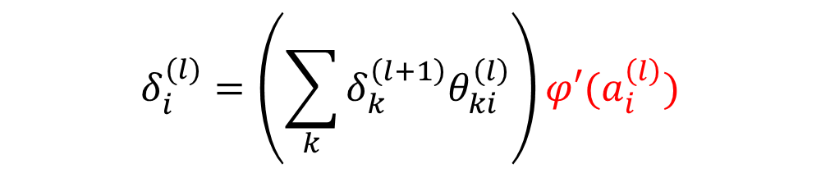
NN Recap: backpropagation
$$a^{(1)}$$
$$a^{(2)}$$
$$a^{(3)}$$
$$a^{(4)}$$
$$δ^{(2)}$$
$$δ^{(3)}$$
$$δ^{(4)}$$
Layer 1
Layer 2
Layer 3
Layer 4
Layer 1
Layer 2
Layer 3
Layer 4
$$\text{cost} \text{function}\text{: }J\left(Θ\right)=−\frac{1}{m}\sum_{i=1}^{m}{ℓ(h_{Θ}(x^{(i)}))}$$
$$δ_{i}^{(l)}=\left(\sum_{k}{δ_{k}^{\left(l+1\right)}θ_{ki}^{\left(l\right)}}\right){φ′(a}_{i}^{\left(l\right)})$$
$$\frac{∂J(Θ)}{∂θ_{ij}^{(l)}}=a_{j}^{(l)}δ_{i}^{(l+1)}$$
$δ_{i}^{(L)}=$ $ℓ′(h_{Θ}(x^{(i)}$))
$$a_{j}^{(l)}$$
$$θ_{ij}^{(l)}$$
When computing the δ entry for a hidden unit we use
the derivative of the activation function of such a unit
$$a_{i}^{(l+1)}$$

Slide 12
Why Non-linear activation functions
If only linear activation functions one single unit is sufficient
If non linear functions → NN universal function approximators
Which activation function
  Output layer / regression → linear unit
  Output layer / classification → logistic units (class probabilities)
  Hidden layers
    Until ‘90s logistic
    90’s-2000’s tanh
    Now ReLU

Slide 13
Comparisons on activation functions pros-cons
https://towardsdatascience.com/analyzing-different-types-of-activation-functions-in-neural-networks-which-one-to-prefer-e11649256209
https://machinelearningmastery.com/rectified-linear-activation-function-for-deep-learning-neural-networks/

Slide 14
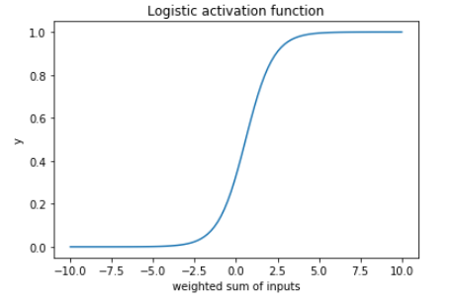
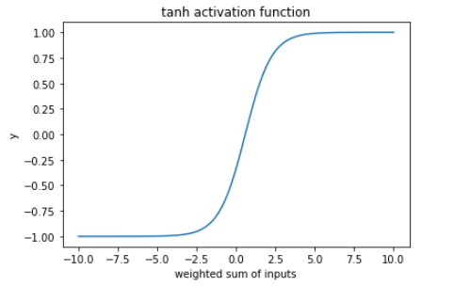
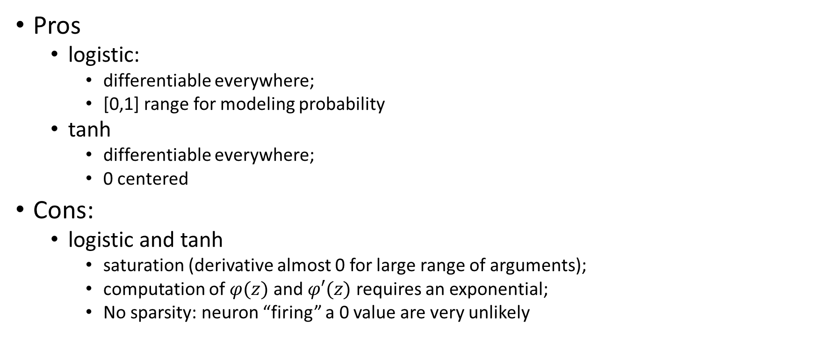
Comparisons on activation functions pros-cons
Pros
  logistic:
    differentiable everywhere;
    [0,1] range for modeling probability
  tanh
    differentiable everywhere;
    0 centered
Cons:
  logistic and tanh
    saturation (derivative almost 0 for large range of arguments);
    computation of $φ(z)$ and $φ′(z)$ requires an exponential;
    No sparsity: neuron “firing” a 0 value are very unlikely

Slide 15

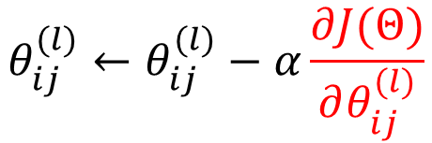


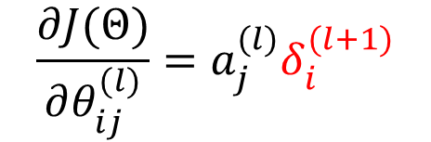

Sigmoid functions: issues
Saturation of the activation of a given neuron means that parameters of input connections of the neuron will no longer be updated
Vanishing gradient: if the derivative is different than 0 but still close to 0 (very likely for sigmoids), backprop will compute δs that will be more and more close to 0 if several layers are involved since first layers will have δs obtained by multiplying very small numbers (more in the following)
$$θ_{ij}^{(l)}$$
$$\frac{∂J(Θ)}{∂θ_{ij}^{(l)}}=a_{j}^{(l)}δ_{i}^{(l+1)}$$
$$δ_{i}^{(l+1)}=K{φ′(a}_{i}^{\left(l+1\right)})$$
$$a_{j}^{(l)}$$
$$a_{i}^{(l+1)}$$
$$θ_{ij}^{(l)}←θ_{ij}^{(l)}−α\frac{∂J(Θ)}{∂θ_{ij}^{(l)}}$$
Gradient descent
0

Slide 16



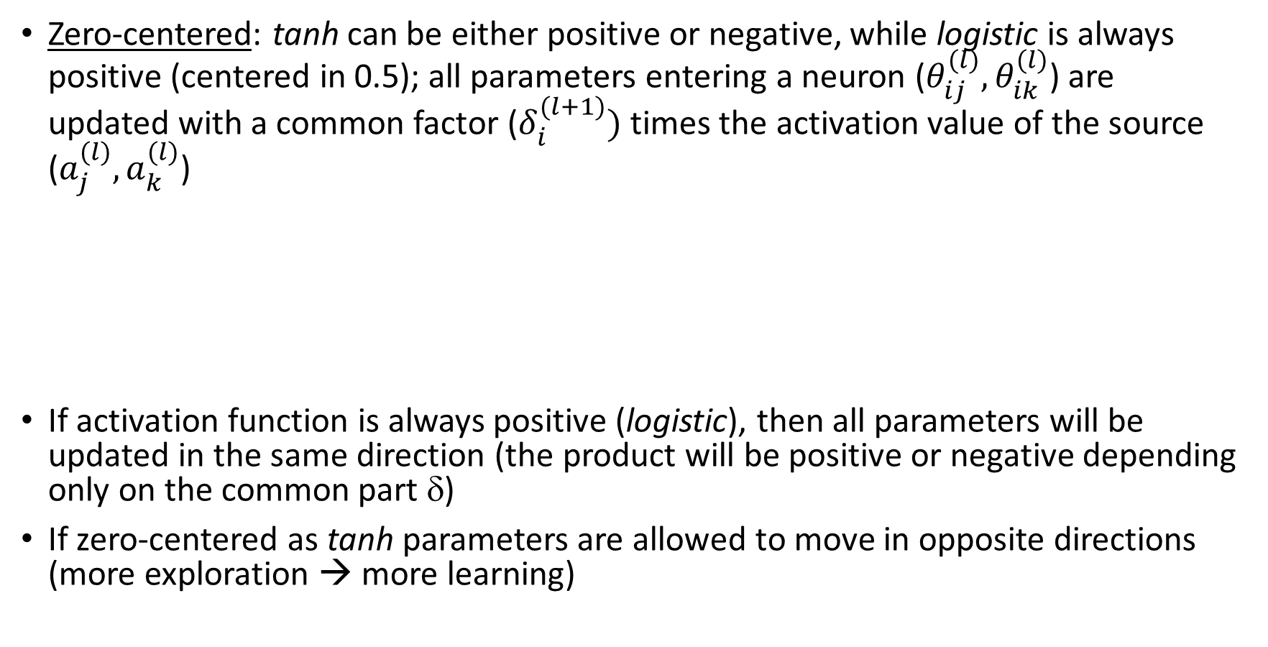
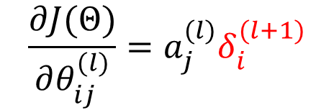

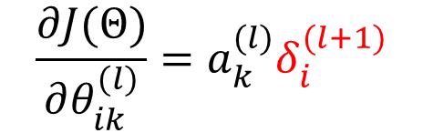


Sigmoids functions: issues
Zero-centered: tanh can be either positive or negative, while logistic is always positive (centered in 0.5); all parameters entering a neuron ($θ_{ij}^{(l)}, θ_{ik}^{(l)}$) are updated with a common factor ($δ_{i}^{(l+1)})$ times the activation value of the source ($a_{j}^{(l)}, a_{k}^{(l)}$)
If activation function is always positive (logistic), then all parameters will be updated in the same direction (the product will be positive or negative depending only on the common part δ)
If zero-centered as tanh parameters are allowed to move in opposite directions (more exploration → more learning)
$$\frac{∂J(Θ)}{∂θ_{ij}^{(l)}}=a_{j}^{(l)}δ_{i}^{(l+1)}$$
$$θ_{ij}^{(l)}$$
$$δ_{i}^{(l+1)}=K{φ′(a}_{i}^{\left(l+1\right)})$$
$$a_{j}^{(l)}$$
$$a_{i}^{(l+1)}$$
$$\frac{∂J(Θ)}{∂θ_{ik}^{(l)}}=a_{k}^{(l)}δ_{i}^{(l+1)}$$
$$a_{k}^{(l)}$$
$$θ_{ik}^{(l)}$$

Slide 17
Sigmoid functions: issues
Sparsity: means that in a large network (many layers and many hidden units), several neurons are not activated
If the networks is large, it is reasonable that specific parts will be devoted to specific tasks, thus when an input is processed, only the neurons devoted to the recognition of such an input should be activated (in a non-deep NN since only a limited number of neurons are available, they should be able to process many types of input, so sparsity is not required)
Sigmoid functions are never exactly equal to 0, thus neurons are never totally deactivated.

Slide 18
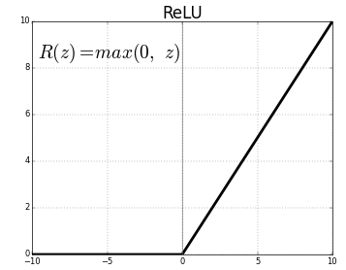
Rectified Linear Unit (ReLU)
Computationally simple (also the derivative)
It acts partly as a linear function but is
is not linear
May output an actual 0 value (sparsity)
No saturation → gradient flows well (it
remains proportional to node’s activation)
To control sparsity (output and gradient =0 or dying ReLU problem) Leaky ReLU or Exponential ReLu
Together with He initialization is a way to avoid unstable gradient (more in the following)

Slide 19
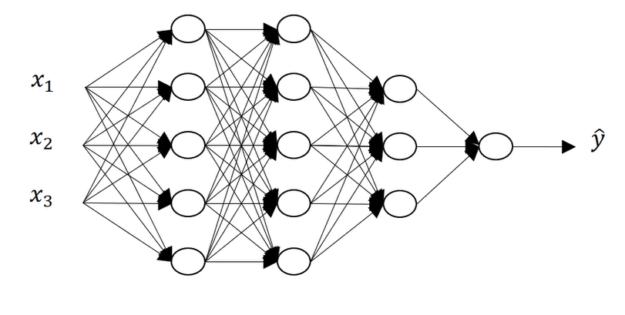
Deep-L Neural Nets
L= number of hidden+output layers
Deep-4 NN

Slide 20

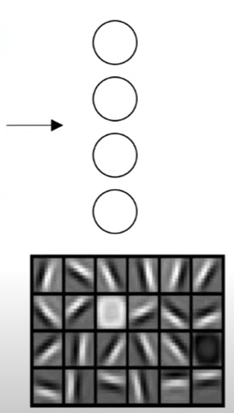
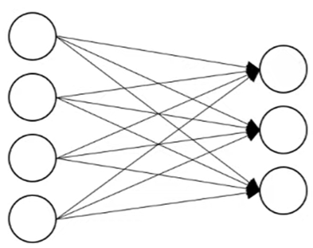
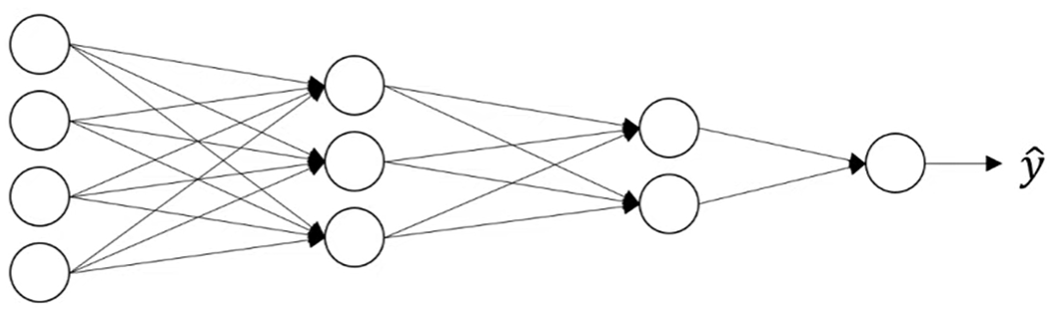
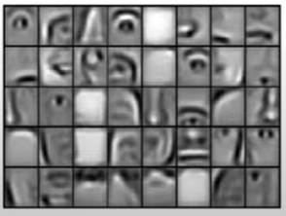
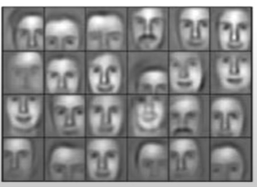
Deep-L NN: why
Hierarchical style of learning (e.g. vision, sound,etc…)
Class (e.g. women)
Edge detectors
Face parts detectors
Face detectors
Audio → low level waveforms → phonemes → words → sentences

Slide 21

Deep-L NN: why
Circuirt theory (shallow net requires exponentially large number of units than deeper smaller nets)
O(log n)
……
O($2^{n}$)

Slide 22
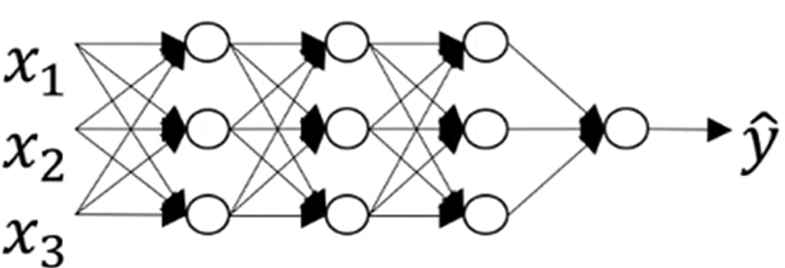
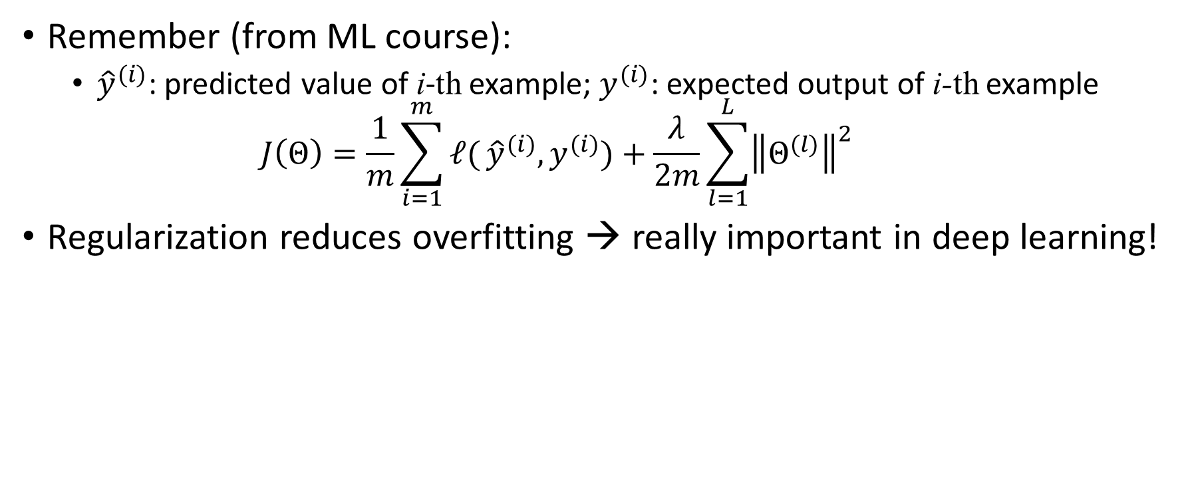
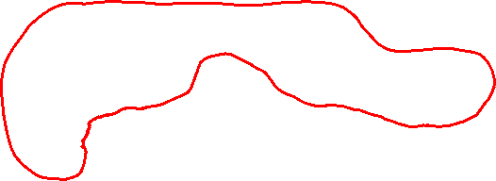

Regularization in NN
Remember (from ML course):
  ${\hat{y}}^{(i)}$: predicted value of i-th example; $y^{(i)}$: expected output of i-th example
  $J\left(Θ\right)=\frac{1}{m}\sum_{i=1}^{m}{ℓ(}{\hat{y}}^{(i)},y^{(i)})+\frac{λ}{2m}\sum_{l=1}^{L}{{\left\|Θ^{(l)}\right\|}^{2}}$
Regularization reduces overfitting → really important in deep learning!
$$λ↑⇒θ_{ij}^{(l)}↓$$
Large λ improve sparsity (i.e., less complex nets)
➔ less prone to overfitting

Slide 23
Regularization effect on activation function
If the function argument is small (near 0), the function is nearly linear
If the weights are small we are in this situation
the net can approximate less complex functions, reducing the risk of overfitting

Slide 24
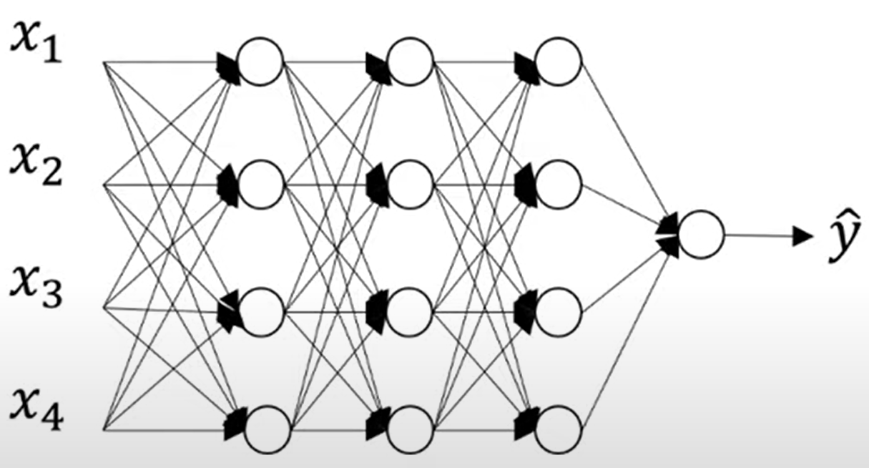
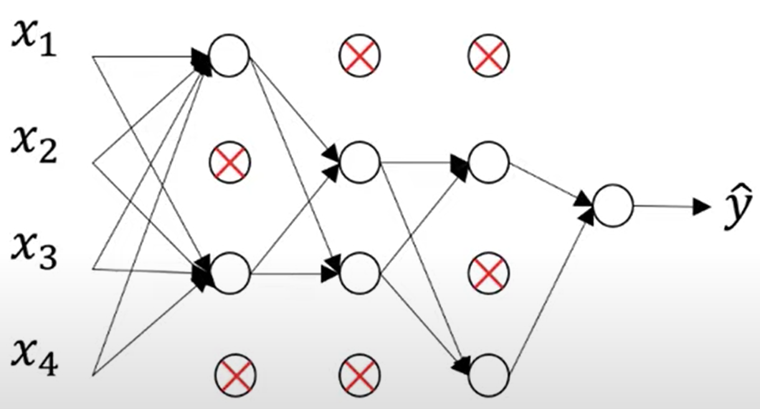
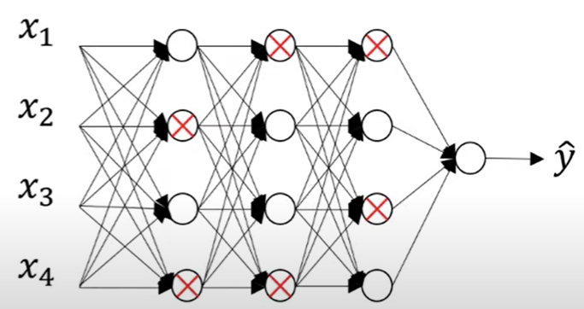
Drop-out Regularization
An alternative to L2 regularization
Going through the layers of the net, setting a drop-out probability p for each node (probability of eliminating the node), and deciding whether to keep or remove the node in accordance to p.

Slide 25
Drop-out
Alternatives:
  set a single drop-out probability for each node in any layer
  set a different drop-out probability for each layer: larger layers should have larger drop-out
  set a single drop-out probability for a set of layer, then using drop-out only for those layers (no drop-out for others)
NB: No dropout at test time
Why it works:
  Simpler nets (less nodes and connections)
  Since (some) nodes are randomly removed, inner units cannot rely on any one feature (or specific subset of features), so weights have to be spread out across the network

Slide 26



Data Augmentation
Helps reducing overfitting
Quite natural in computer vision applications: flipping, cropping, zooming, rotating, distortion, ….

Slide 27
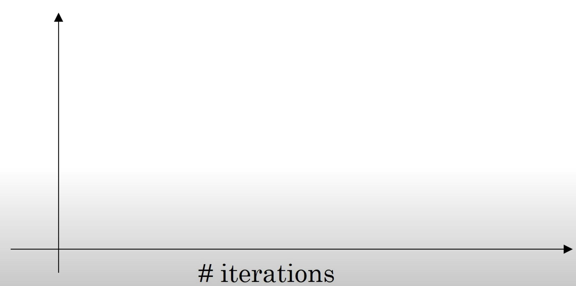
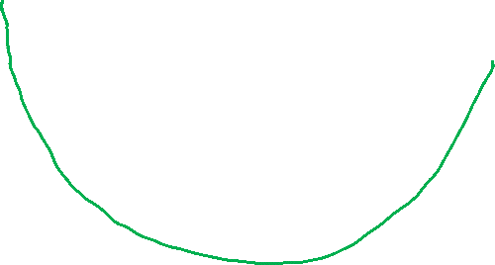
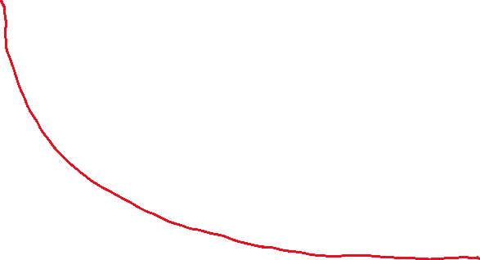
Early stopping
Test error
Train error
stop
Downside of ES: optimize cost function and reduce variance simultaneously
This breaks the ortyhogonality of ML techniques where the two tasks are usually dealt with independently (e.g L2 regularization)

Slide 28

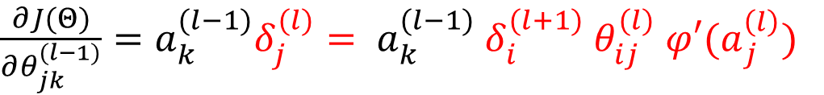







Unstable gradient: vanishing and exploding
$$δ_{j}^{(l)}$$
$$δ_{i}^{(l+1)}$$
$$θ_{jk}^{(l−1)}$$
$$θ_{ij}^{(l)}$$
$$a_{k}^{(l−1)}$$
$$a_{j}^{(l)}$$
$$a_{i}^{(l+1)}$$
$\frac{∂J(Θ)}{∂θ_{jk}^{(l−1)}}=a_{k}^{(l−1)}δ_{j}^{(l)}= a_{k}^{(l−1)}$ $δ_{i}^{(l+1)}$ $θ_{ij}^{(l)}$ ${φ′(a}_{j}^{\left(l\right)})$
$$\frac{∂J(Θ)}{∂θ_{ij}^{(l)}}=a_{j}^{(l)}δ_{i}^{(l+1)}$$
Each gradient is a product depending on weigths and on derivative of activation function
Shallow layer will have larger products
If weights and derivative of activation functions are small, the gradient tends to vanish (large product of small values): this may happen when using sigmoids functions (derivative between 0 and 1, with several small values), and weights not properly initialized (es: Ν(0,1))
If weights are initialized as very large, they may dominate in the product and the gradient tends to explode (becomes larger and larger towards shallow layers)
In both cases different layers learn parameter at different speed (unstable learning)

Slide 29

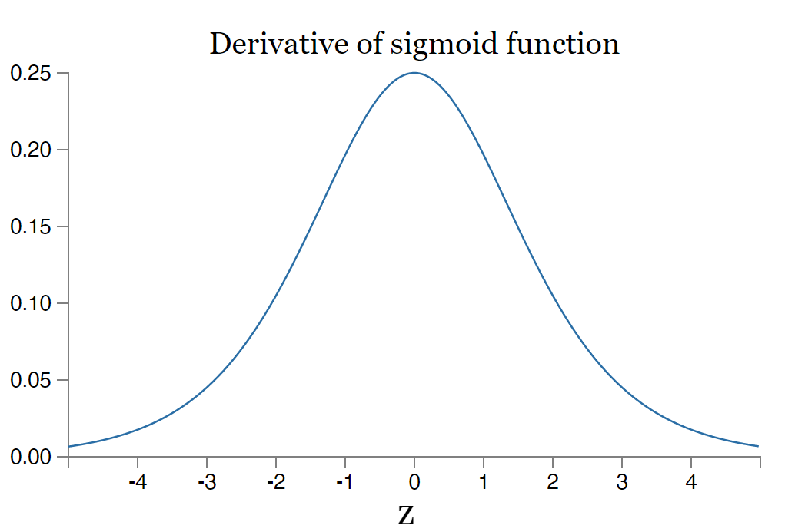
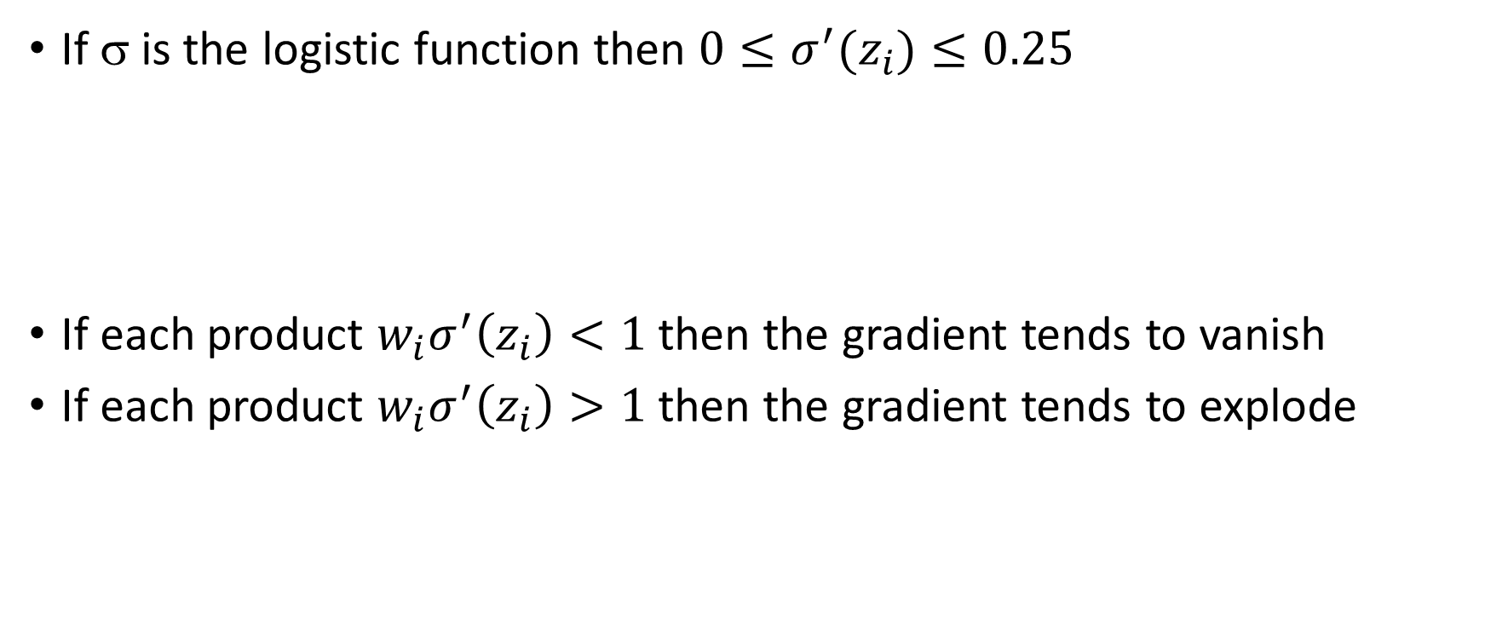
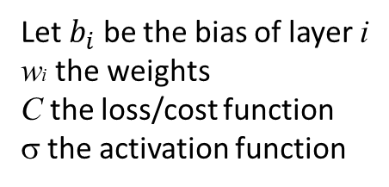
Example
Let $b_{i}$ be the bias of layer i
wi the weights
C the loss/cost function
σ the activation function
Derivative of logistic function
If σ is the logistic function then ${0≤σ}^{′}(z_{i})≤0.25$
If each product $w_{i}σ^{′}\left(z_{i}\right)<1$ then the gradient tends to vanish
If each product $w_{i}σ^{′}\left(z_{i}\right)>1$ then the gradient tends to explode

Slide 30



Weight initialization
Good initialization to avoid unstable gradient
Suppose we standardized input xi and we also initialize the weights θi randomly from N(0,1):
  We sum 4 products having mean=0 and var=1; z will have mean=0 and var=4
  In general if n is the number of inputs, z will have mean=0 and var=n (std=$\sqrt{n})$
  So for large n, the variance is too big and z tends to explode or vanish
We can keep std=1 in each layer by rescaling weights of a factor $\frac{1}{\sqrt{n^{(l−1)}}}$ where $n^{(l−1)}$ is the number of neurons at level l-1 (# inputs at layer l)
  $θ_{ij}^{(l)}=rand_norm(0,1)\frac{1}{\sqrt{n^{(l−1)}}}$ (linear activation)
  $θ_{ij}^{(l)}=rand_norm(0,1)\sqrt{\frac{2}{n^{(l−1)}}}$ (Relu activation)
  $θ_{ij}^{(l)}=rand_norm(0,1)\sqrt{\frac{2}{n^{(l−1)}+n^{(l)}}}$ (tanh activation)
$z=θ_{1}x_{1}+θ_{2}x_{2}+$ $θ_{3}x_{3}+$ $θ_{4}x_{4}$
He initialization
Xavier initialization
Xavier Glorot and Yoshua Bengio:
Understanding the difficulty of training deep feedforward neural networks
Notes:
Notes: rand.norm(0,1) restituisce tipicamente valori in [-1,1]; molti sostituiscono con Uniform(-1,1)

Slide 31
Summary
In deep networks we need non linear activation functions
Sigmoids (logistic and tanh) together with improper weight initialization may produce unstable gradient during backprop
Xavier initialization can be adopted if one want to use tanh
ReLU and variants, together with He initialization are the state of the art in Deep FF network (and in Convolutional Networks as we will see next); they usually perform better than other alternatives

